Slide 1
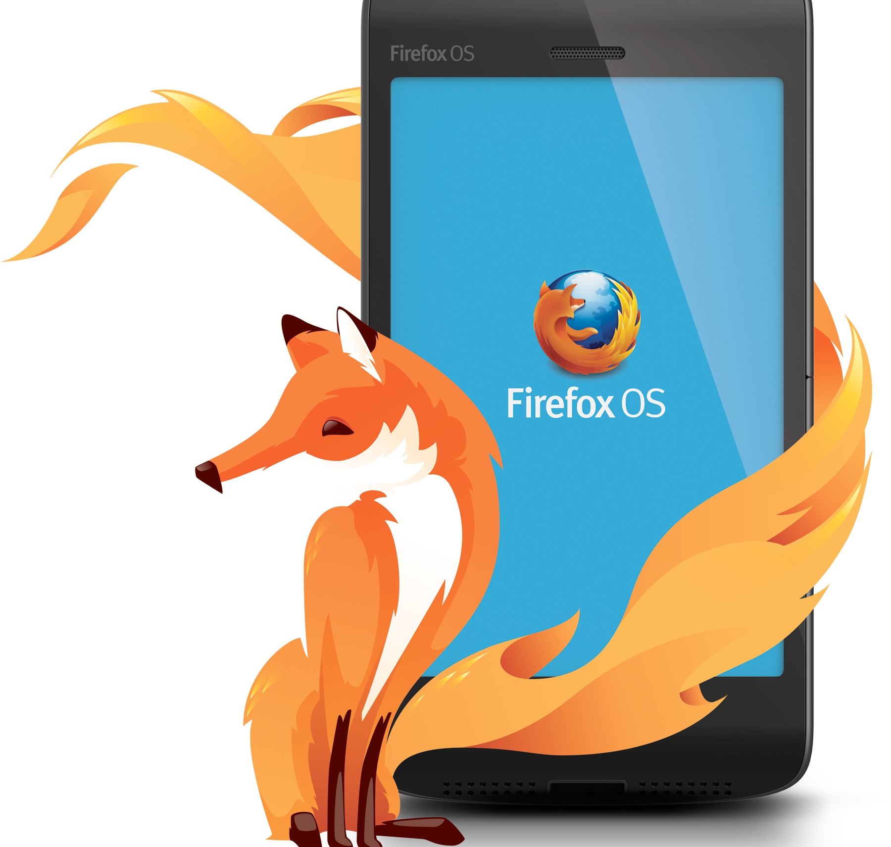
Pivoting Firefox OS to Connected Devices
Alex Lakatos, CodeCamp, May 2016
Notes:
Alex Lakatos
Mozilla Reps Mentor, that basically means I’m a volunteer that helps other people volunteer. We have some mozillians in the room as well, feel free to hunt them down after my talk and ask them questions. They’re semi-friendly.
I am going to talk today about Firefox OS and how we pivoted it to the Connected Devices space.
First off, how many of you have heard about Firefox OS? (raise hands)

Slide 2
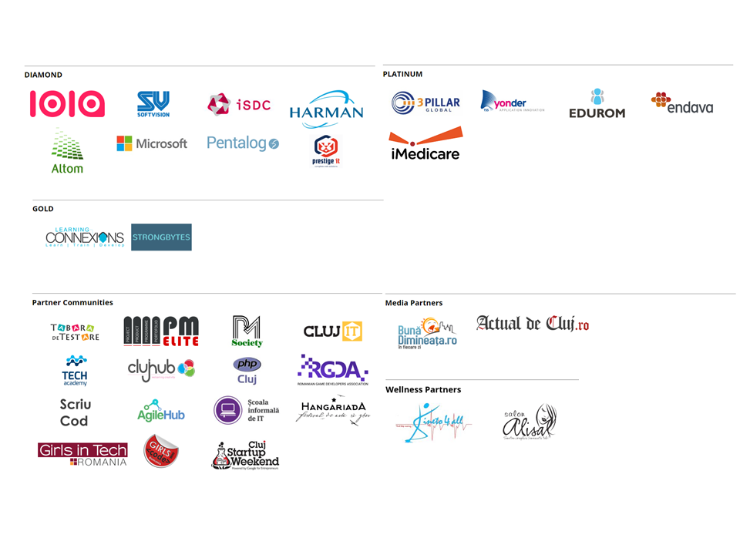

Slide 3

Going Mobile

Slide 4

Building for Mobile

Slide 5

NO SDK?

Slide 6
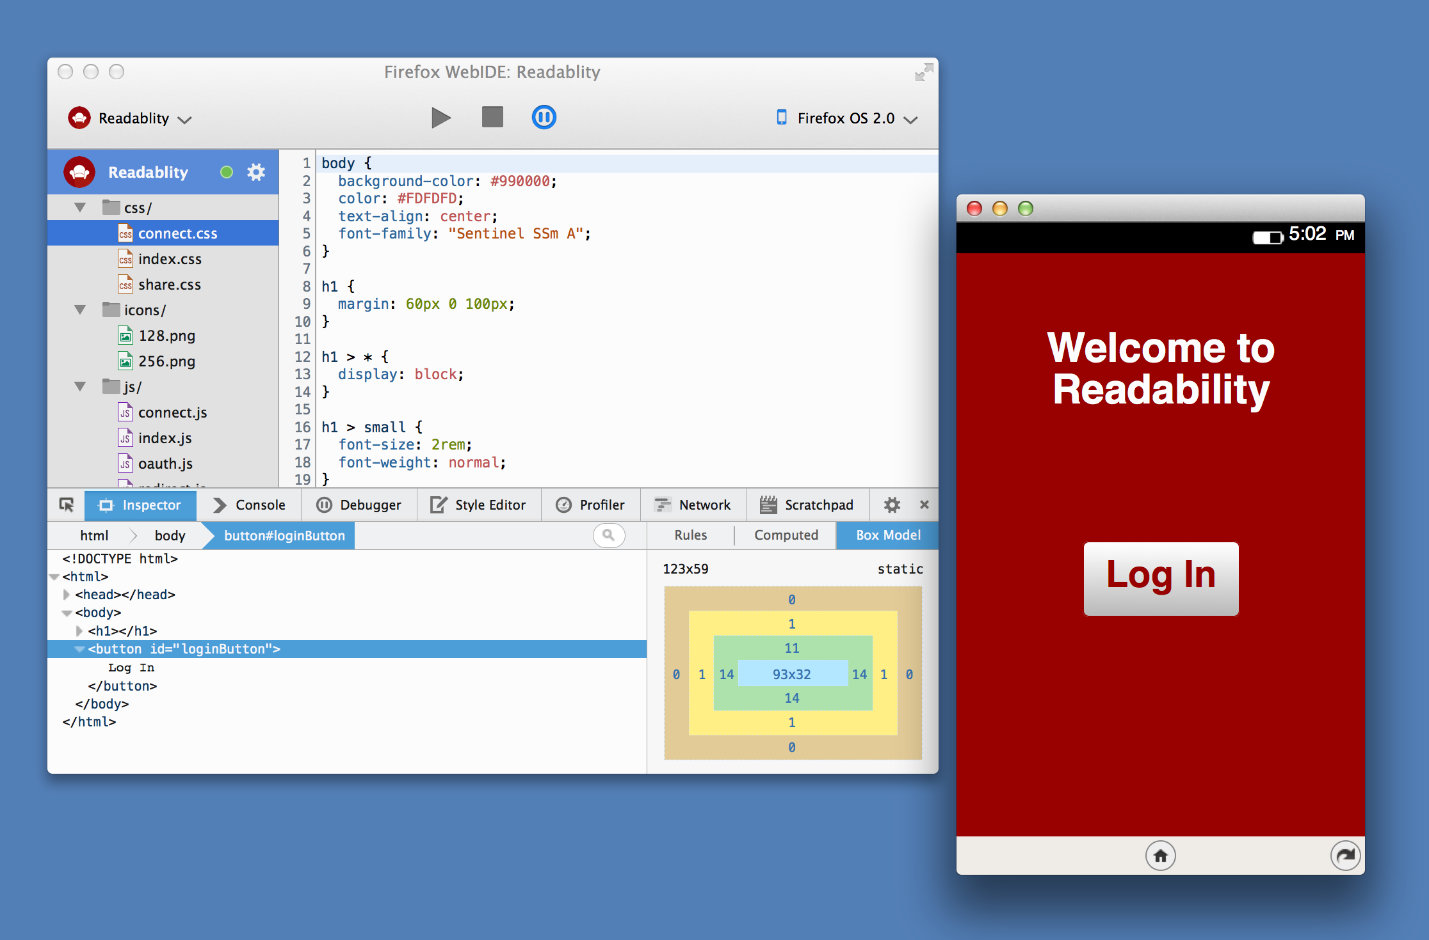

Slide 7


Slide 8
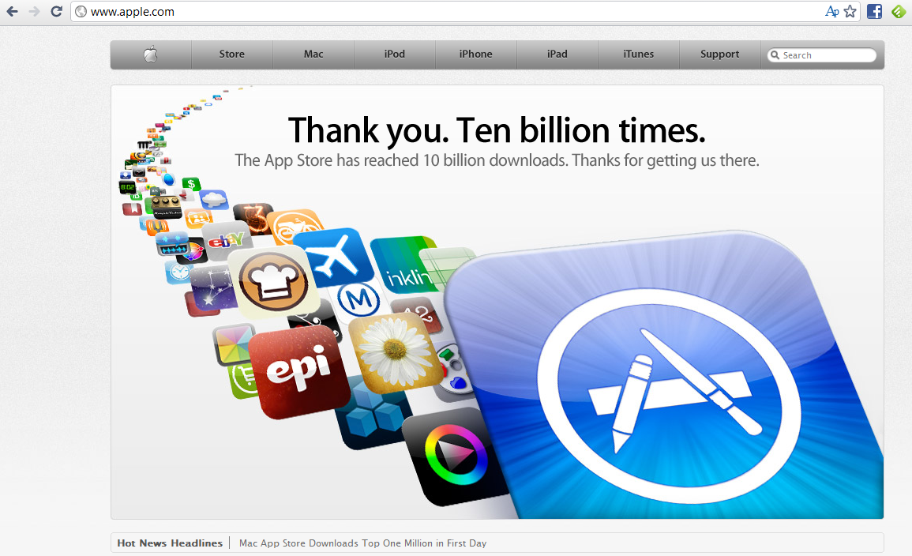

Slide 9
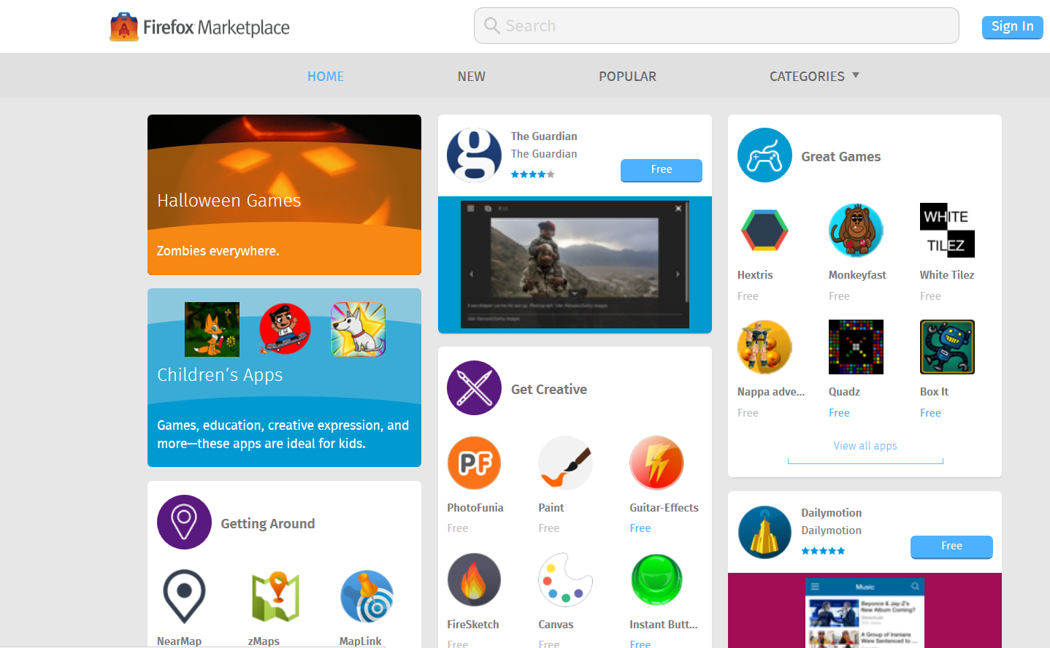

Slide 10


Slide 11
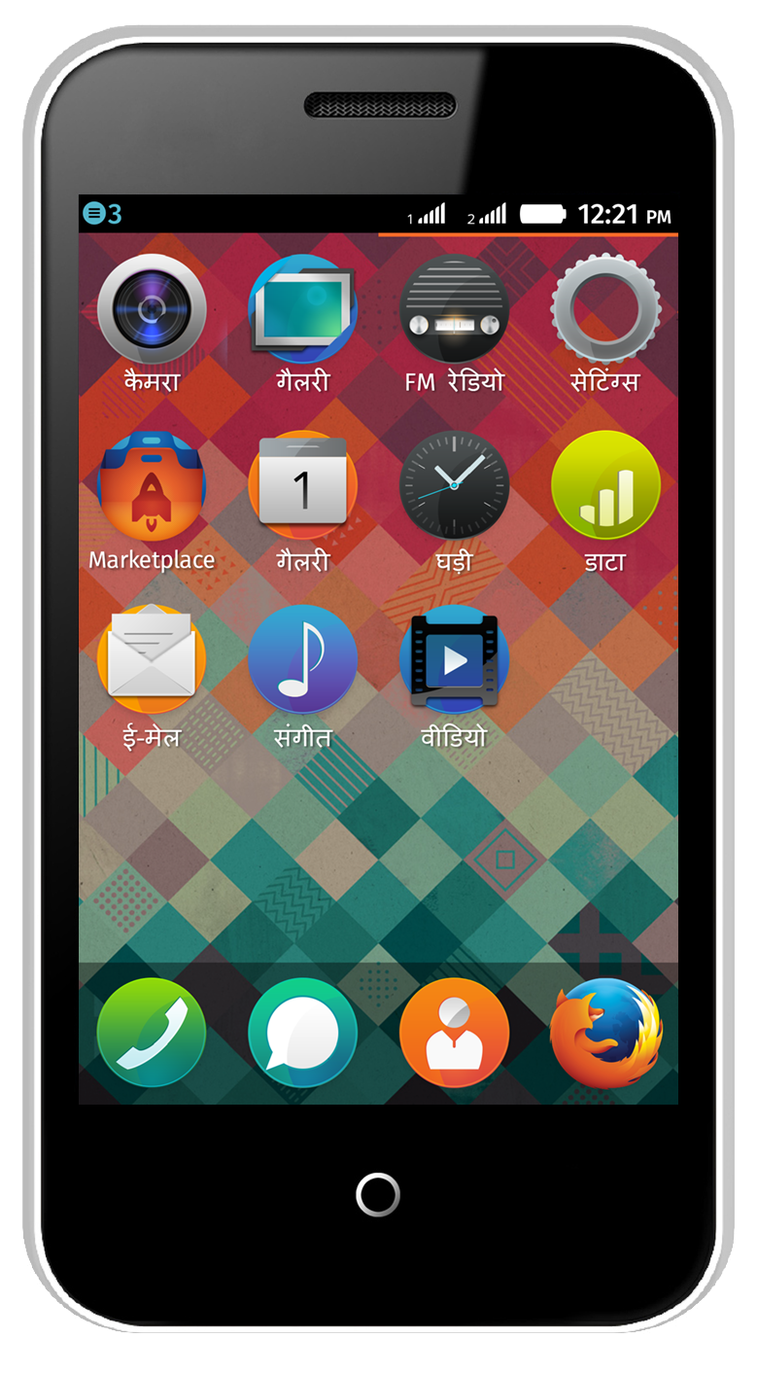
India
Intex Cloud FX
2 MP Rear camera
Spd 6821 1.0GHz
RAM-128MB
ROM-256MB
Display–3.5”HVGA
Dual SIM
1250mAh (Li-ion)
Bluetooth/Wi-Fi
Price?

Slide 12
India
Intex Cloud FX
2 MP Rear camera
Spd 6821 1.0GHz
RAM-128MB
ROM-256MB
Display–3.5”HVGA
Dual SIM
1250mAh (Li-ion)
Bluetooth/Wi-Fi
Price 20£

Slide 13
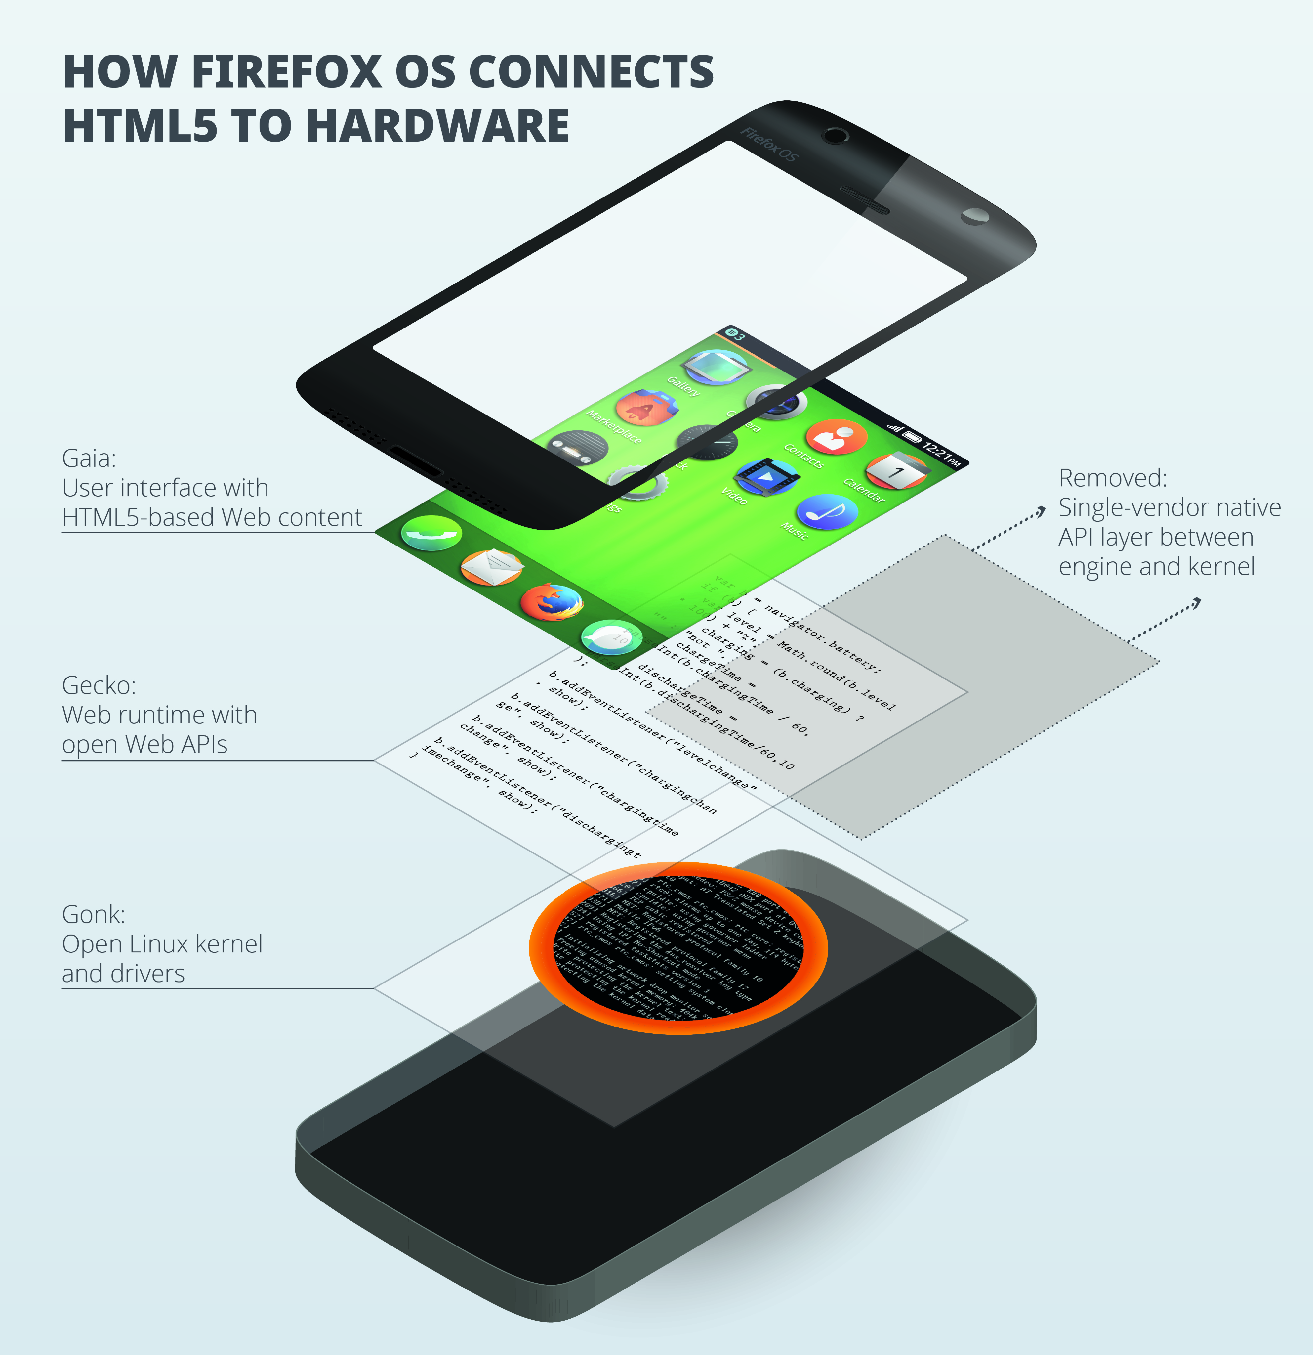

Slide 14
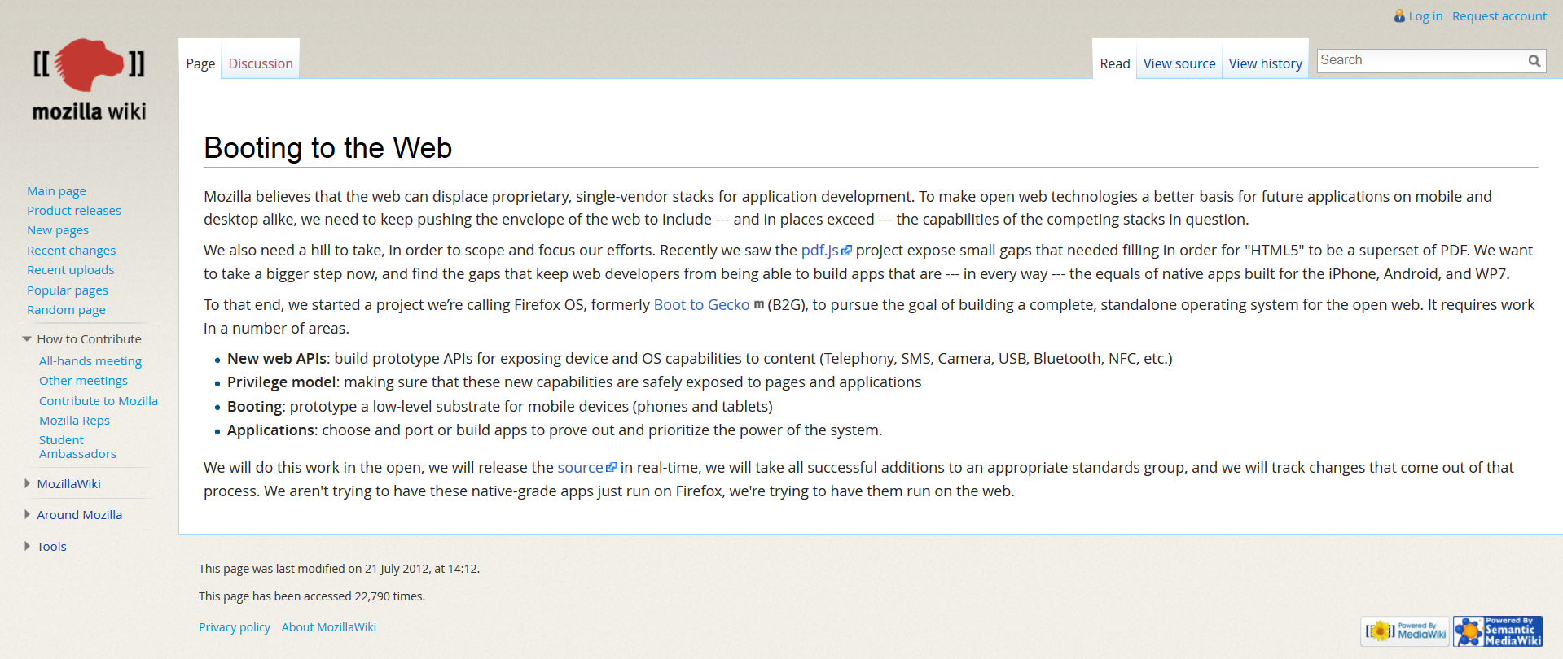
29 March 2012
https://wiki.mozilla.org/Booting_to_the_Web

Slide 15
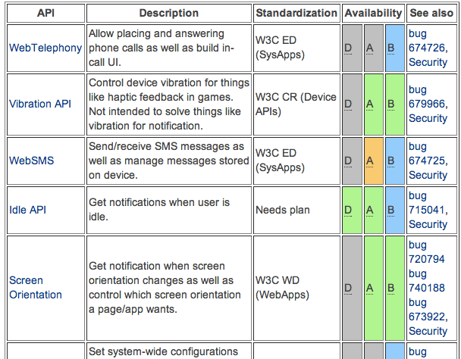
Web APIs
https://wiki.mozilla.org/WebAPI

Slide 16
Web APIs
Vibration API
Screen Orientation
Geolocation API
Mouse Lock API
Open WebApps
Network Information API
Battery Status API
Alarm API
Push Notifications API
WebFM API / FMRadio
WebPayment
IndexedDB
Ambient light sensor
Proximity sensor
Notification

Slide 17
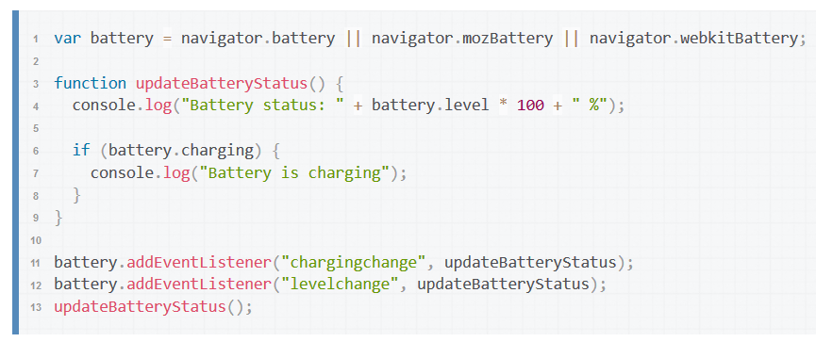
Battery API

Slide 18
Web APIs (privileged apps)
Device Storage API
Browser API
TCP Socket API
Contacts API
systemXHR

Slide 19
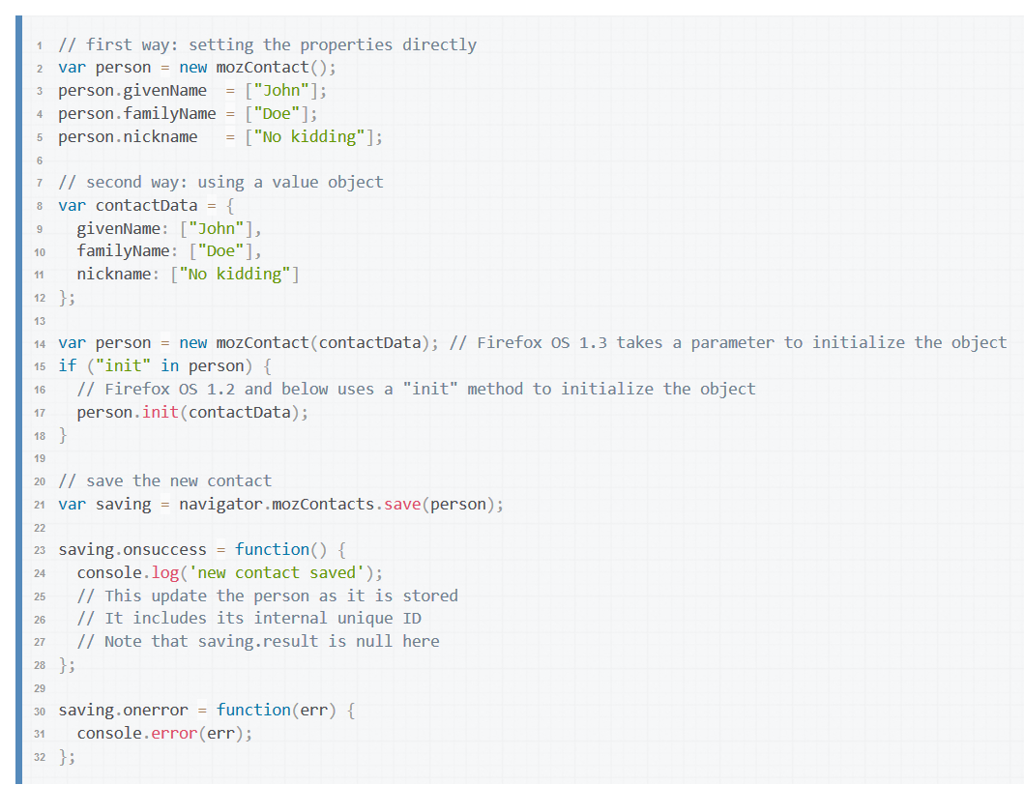
Contacts API

Slide 20
Web APIs (certified apps)
WebTelephony
WebSMS
Idle API
Settings API
Power Management API
Mobile Connection API
WiFi Information API
WebBluetooth
Permissions API
Network Stats API
Camera API
Time/Clock API
Attention screen
Voicemail

Slide 21
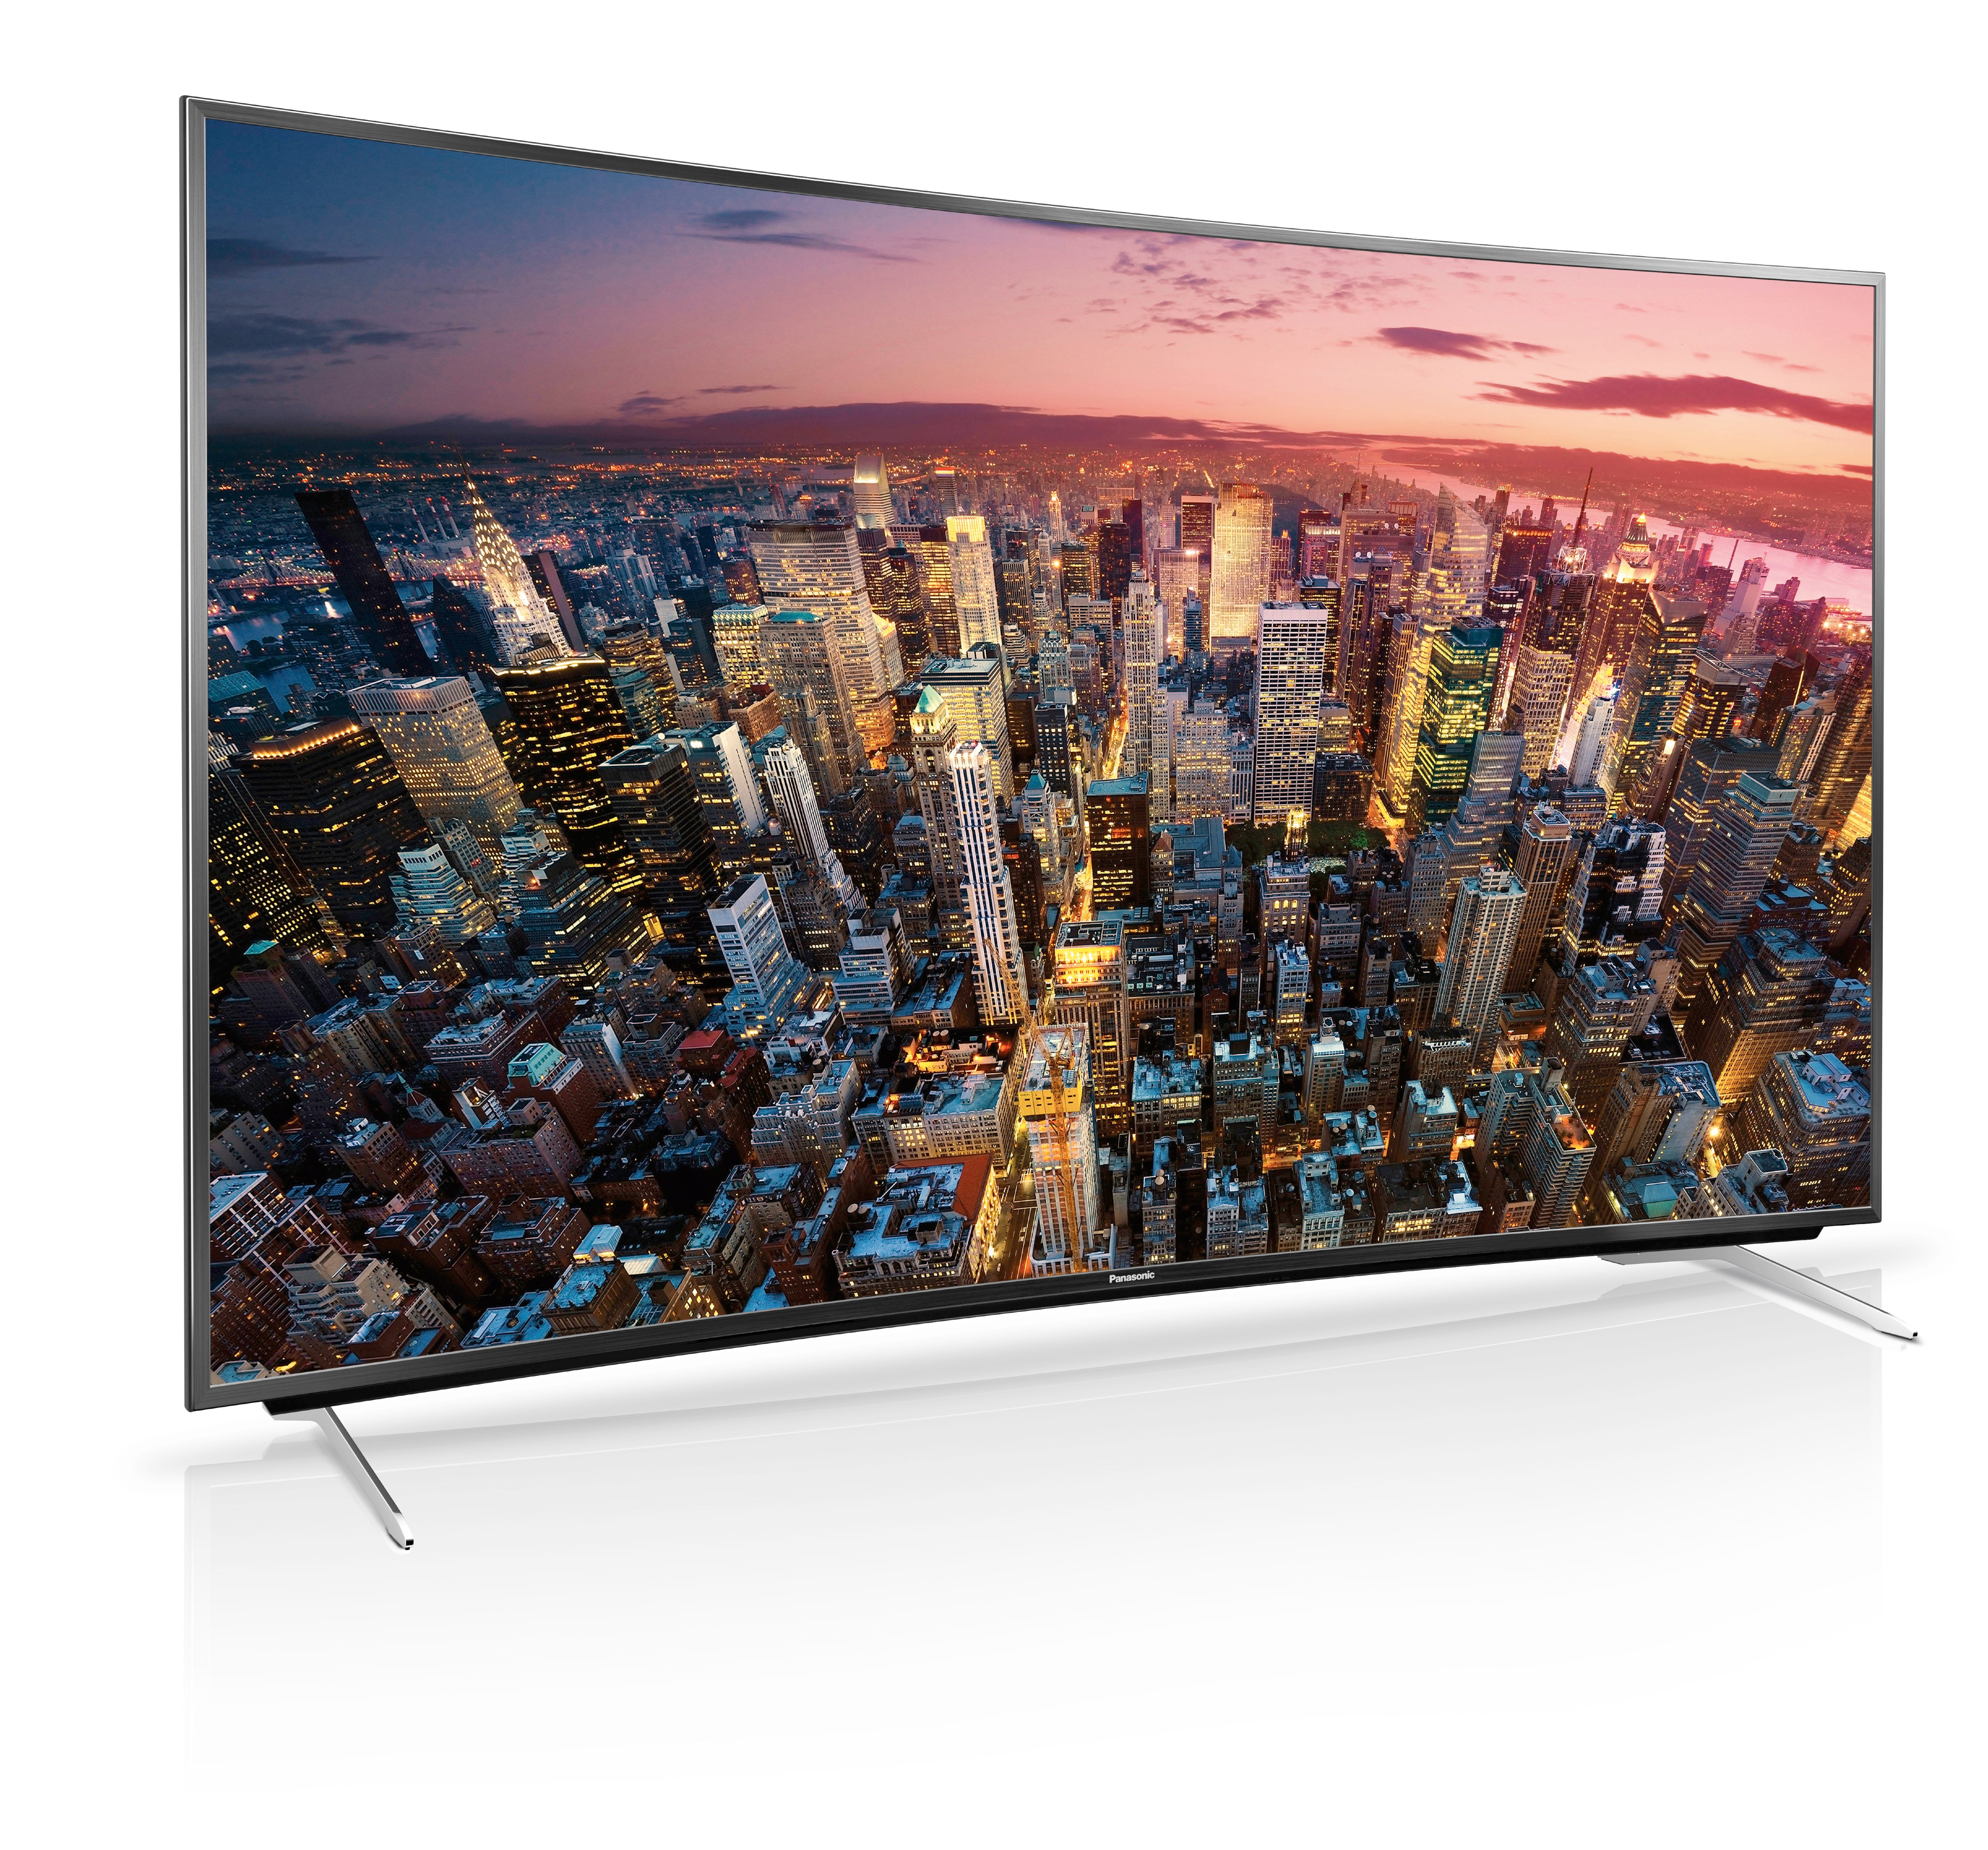
Some Facts
18 smartphones
16 operators
32 countries
TV

Slide 22
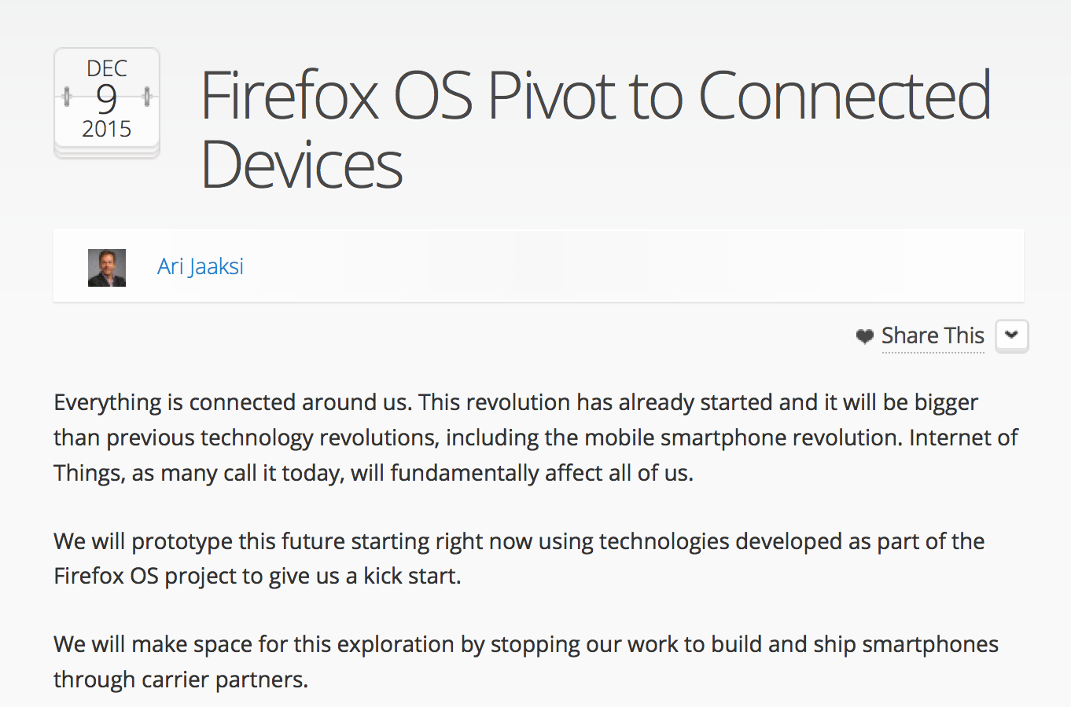
9 December 2015

Slide 23
Smartphone Transition
Firefox OS for Smartphone Code Base Transition
Volunteer Contributor Community Engagement
Smartphone Commercial Ramp-Down
Notes:
Transition the Firefox OS for Smartphone code to reduce its maintenance cost and get it into a state where the volunteer contributor community can successfully take the lead and ownership for the future direction of the b2g for smartphone

Slide 24
SmartPhone Code Transition
Firefox OS for Smartphone Code Base Transition
Modernize the B2G platform (replace legacy mozApps-only APIs with new web standards)
Move towards an architecture closer to that of the Firefox browser (just chrome and web content)
Transition smartphone modules to new owners and peers in the community

Slide 25
B2G/Transition Project
Volunteer Contributor Community Engagement
Modernise the B2G platform (replace legacy mozApps-only APIs with new web standards)
Create a leaner platform on which to build Smart TV and other connected devices products (reduced complexity and maintenance cost)
Move towards an architecture closer to that of the Firefox browser (just chrome and web content)
Transition smartphone modules to new owners and peers in the community
Build a more active open source community around the project
Notes:
Goals:
Modernise the B2G platform (replace legacy mozApps-only APIs with new web standards)
Create a leaner platform on which to build Smart TV and other connected devices products (reduced complexity and maintenance cost)
Move towards an architecture closer to that of the Firefox browser (just chrome and web content)
Transition smartphone modules to new owners and peers in the community
Build a more active open source community around the project

Slide 26
B2G/Transition Project
Gonk Changes
APIs needed for TV will be maintained by staff on the TV team
Smartphone-specific APIs will need to be maintained by the wider community
Merge the B2G process model with the Firefox process model
Notes:
Gonk Changes
APIs needed for TV will be maintained by staff on the TV team
Smartphone-specific APIs will need to be maintained by the wider community
Merge the B2G process model with the Firefox process model

Slide 27
B2G/Transition Project
Gecko Changes
Replace mozApps with standard web apps (Service Workers, Manifest and Push)
Remove themes and langpacks and add support for Web Extensions
Find an alternative solution to legacy mozApps-only APIs
IAC
DataStore
System Messages
Web Activities
Notes:
Gecko Changes
Replace mozApps with standard web apps (Service Workers, Manifest and Push)
Remove themes and langpacks and add support for Web Extensions
Find an alternative solution to legacy mozApps-only APIs
IAC
DataStore
System Messages
Web Activities

Slide 28
B2G/Transition Project
Gaia Changes
No longer built as mozApps (app://)
Turn system UI into (chrome://) (reason?)
System app
Home screen
Search
Keyboard
Settings?
Turn everything else into web content where possible (http://)
Hosted on localhost
Hosted on the web
Notes:
Gaia Changes
No longer built as mozApps (app://)
Turn system UI into (chrome://) (reason?)
System app
Home screen
Search
Keyboard
Settings?
Turn everything else into web content where possible (http://)
Hosted on localhost
Hosted on the web

Slide 29
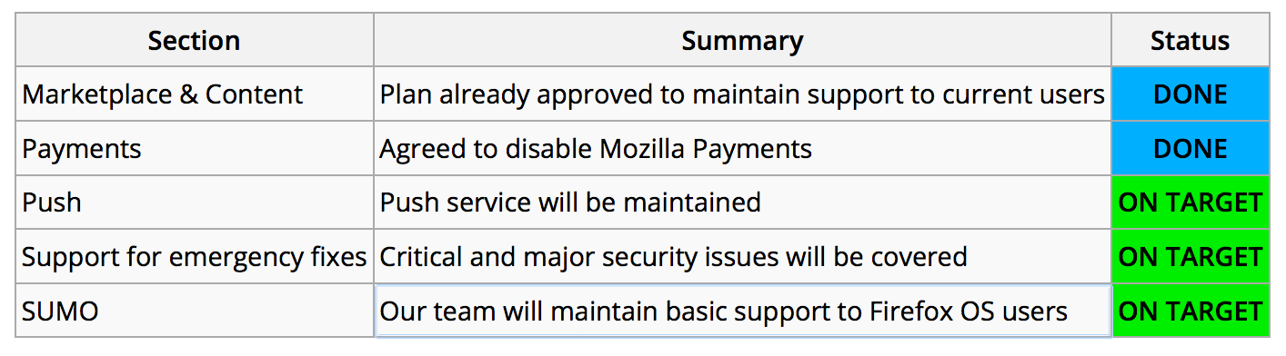
Smartphone Commercial Transition
Smartphone Commercial Ramp-Down
Notes:
After Mozilla’s decision to stop launching Firefox OS smartphones through carriers or in the free market, we need to evaluate and plan the level of support and the services that are still needed for active Firefox OS users, as well as the internal activities that need to be completed to appropriately close out our FxOS project. The aim of this project is to provide a fair and good level of support for existing commercial users in multiple aspects (Marketplace, Content, Push services, Support for users, etc).
Review and analysis has resulted in a recommendation to have a transition period of two years (through Q1 2018) to maintain Firefox OS smartphone environment to support current users. In addition, Mozilla will keep monitoring activity metrics during this time, to have a confident measure of the real user activity in the wild.
Project Status
Marketplace & Content
Plan already approved to maintain support to current users
DONE
Payments
Agreed to disable Mozilla Payments
DONE
Push
Push service will be maintained
ON TARGET
Support for emergency fixes
Critical and major security issues will be covered
ON TARGET
SUMO
Our team will maintain basic support to Firefox OS users
ON TARGET

Slide 30
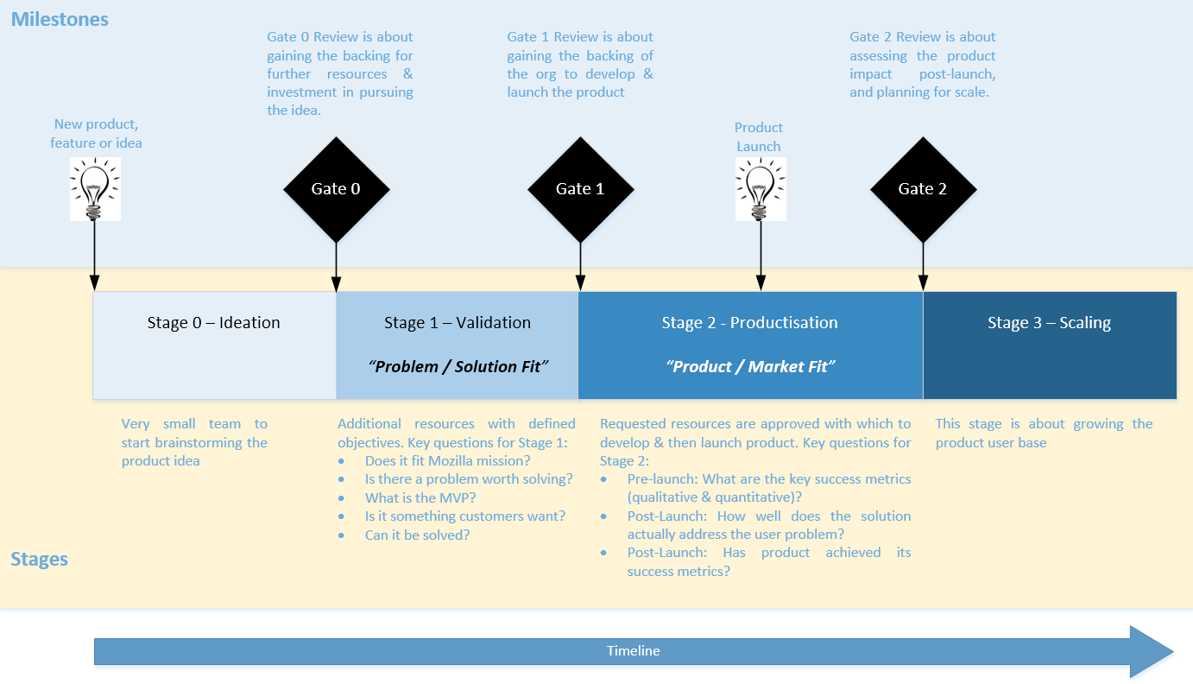
Product Innovation Process
Notes:
focus on building products with a clear value proposition aimed at the target customers.
ensure new projects align with mission, and track to realistic goals.
be open to enable anyone to surface a great product idea.
ensure clear, consistent decisions by the Exec team.
carefully select the places to invest with transparency of decisions.
support rapid prototyping for new ideas or business models.
fail “bad-ideas” fast.
allow us to refine good ideas in order to build ever more compelling products.
measure success in investing in innovation.
and to be relevant to our customers, we need to move ever faster.

Slide 31
CD Projects

Slide 32
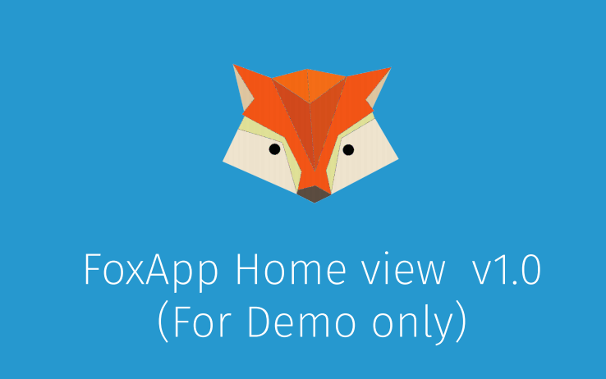
Project Link
Notes:
Project Link: Your personal user agent that understands your preferences for how you want to interact with the world of devices in your home, and automate your connected world for you. All of this still done conveniently and securely, but completely under your control.

Slide 33
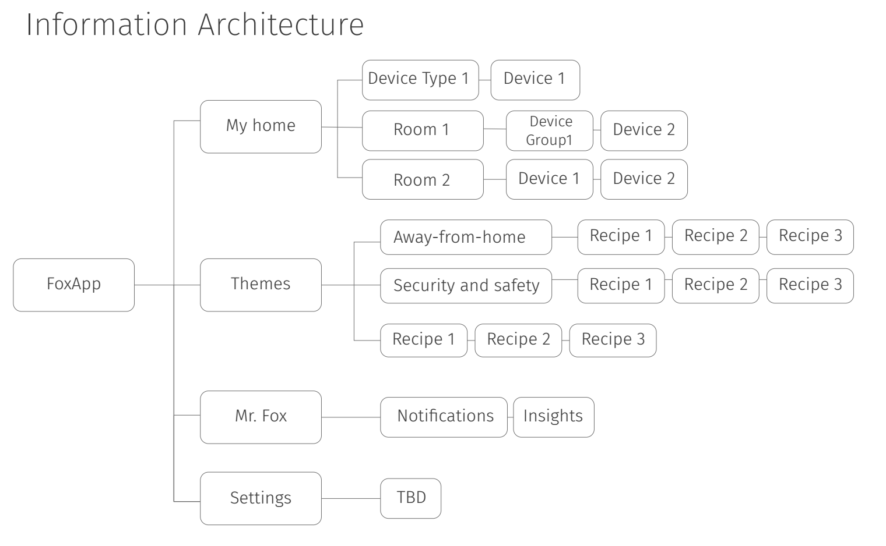
Project Link
Notes:
Project Link (formerly Foxlink) is a short-term experiment to build software building blocks that can interact with various "things". Most code is done in Rust.
We are using the "Design Thinking" innovation approach by IDEO, where the philosophy of Product Innovation is at the center of technology (feasibility), person (desirability) & business (viability).

Slide 34
Project Link
Setup "Link"
Have their devices that use Z-wave/WiFi protocols be discovered by Link
Interact & control their devices whether they are home or remote via a web-app.
Configure rules around how these devices should automatically interact with each other for specific scenarios
Receive notifications
Notes:
Phase 1 - As the first step, we worked toward delivering a prototype that allows a user to -
Setup "Link"
Have their devices that use Z-wave/WiFi protocols be discovered by Link
Interact & control their devices whether they are home or remote via a web-app.
Configure rules around how these devices should automatically interact with each other for specific scenarios
Receive notifications

Slide 35
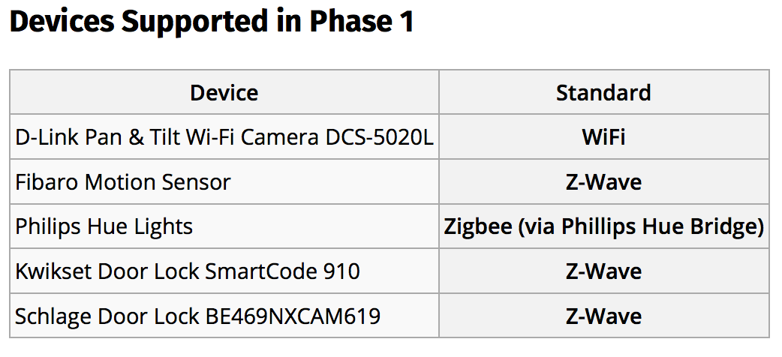
Project Link
Notes:
Devices Supported in Phase 1
Device
D-Link Pan & Tilt Wi-Fi Camera DCS-5020L
Fibaro Motion Sensor
Philips Hue Lights
Kwikset Door Lock SmartCode 910
Schlage Door Lock BE469NXCAM619

Slide 36
Project Sensor Web
Notes:
Project Sensor Web: The easiest path from sensors to open data for contributors to collaboratively build a detailed understanding of their living environments. We are launching a pilot project to build a crowd-sourced pm2.5 sensor network.

Slide 37
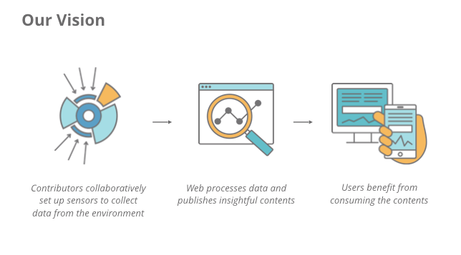
Project Sensor Web
Notes:
SensorWeb wants to advance Mozilla’s mission to promote the open web when it evolves to the physical world. It aims to find the easiest path from sensors to open data so contributors can collaboratively use sensors to get great detail of understanding their living environment. We are launching a pilot project to build a crowdsourcing pm2.5 sensor network.

Slide 38
Project Smart Home
Notes:
Project Smart Home offers a middle ground between "in a box" solutions like Apple Homekit and DIY solutions like Raspberry Pi. Combining modular, affordable hardware with easy-to-use rules, Smart Home empowers people to solve unique everyday problems in new and creative ways.

Slide 39
Project Vaani
Notes:
Project Vaani: An IoT enabler package to developers, device makers and users who want to add a voice interface to their devices in a flexible and customizable way. We will prototype interactions at home in near term, and in future, showcase the ability to access services from the open Web.

Slide 40
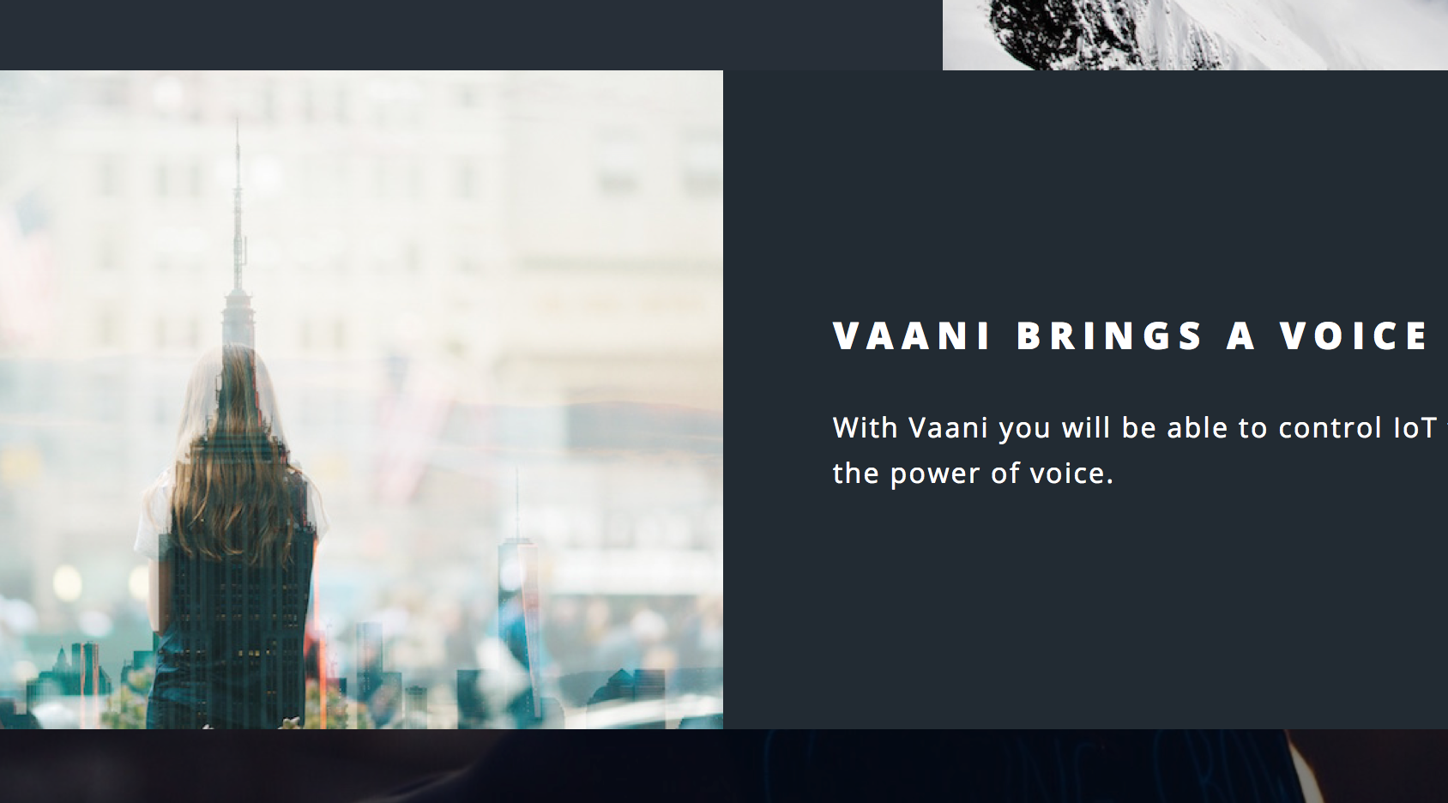
Project Vaani
Notes:
Vaani aims to bring a voice to the Internet of Things (IoT) using open, Mozilla-backed technologies. We believe a voice interface is the most natural way to interact with connected devices, but currently, there are no open solutions available at scale. With Vaani, we plan to offer an "IoT enabler package" to developers, device makers, and end users who want to add a voice interface to their devices in a flexible and customizable way, while avoiding the need to “lock-in” with one of the major commercial players. Initially, Vaani will target smart homes, but will eventually expand to voice-enable a wider range of applications of IoT.

Slide 41
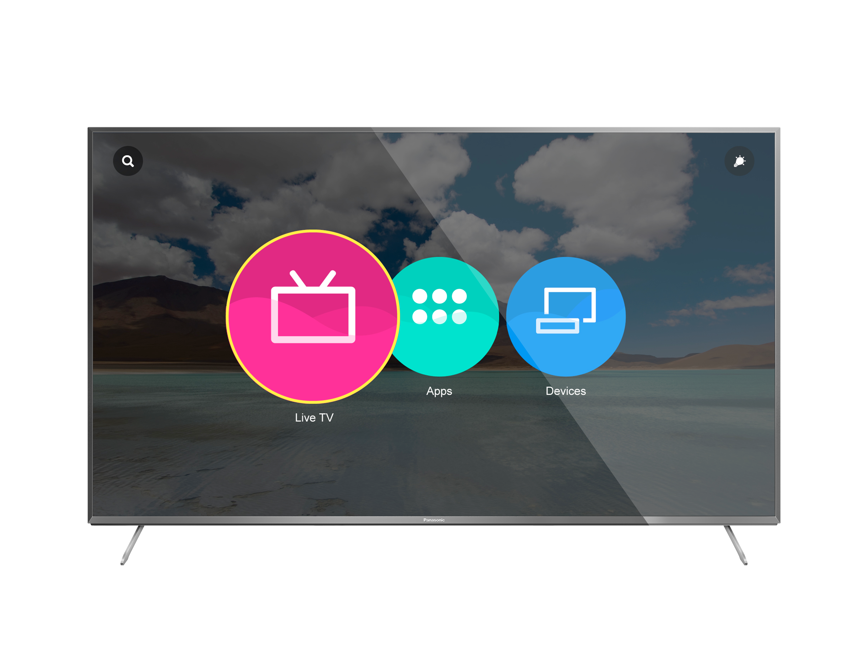
Project SmartTV
Notes:
Panasonic announced in February that Firefox OS will power the new Panasonic DX-series UHD TVs.
Panasonic TVs powered by Firefox OS are already available globally. These TVs have intuitive and customizable home screens which give you “quick access” to Live TV, Apps and personal connected devices. You can access your favorite channels, apps, videos, websites and content quickly – and you can also pin any app or content to your TV home screen.

Slide 42
Project Flyweb
https://youtu.be/j3E4dKNaQRM
Notes:
The web already powers the world's email, media, shopping, and more. Interacting with these things is a breeze because they all use the web. What if the electronics around us were the same?
Meet FlyWeb. FlyWeb is a very simple idea at its core. Instead of phones interacting only with the cloud, they can discover and interact with electronics around them that are running empty web clients, such as TV's, projectors, game consoles, etc. The electronics come to life when connected to phones. The key here is that either the phones serve web apps to these electronics, or the electronics serve web apps to the phones.

Slide 43

Project Magnet
Notes:
Project Magnet is your own, personal user agent for the content that is around you. Instead of getting a list of URLs and you having to browse each link to understand how you can interact with the content, Project Magnet will enable you to have an interactive and friction less experience. The experience will always be fully customizable by you, so you can use it for your maximum enjoyment.

Slide 44
Horizontal Projects
Metrics
Foxfooding
Research & Validation
Notes:
Teams are working in these areas that span horizontally across all of the projects in Connected Devices. Click on the links to see more details related to each project.
Metrics: Having the ability to instrument and determine how we measure success through data and metrics
Foxfooding: How we incorporate our community and early adopters at the start of all our projects
Research & Validation: Analyzing and validating against our users and community on what we build

Slide 45
What do all these projects have in common?
Notes:
What do all these projects have in common?

Slide 46

They need help!
Notes:
Project Magnet is your own, personal user agent for the content that is around you.

Slide 47
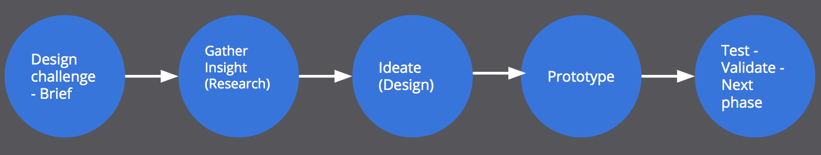
Community Experimentation Launchpad (CEL) - Beta
Notes:
The CEL is being built with input from different teams across Mozilla and volunteers around the world. Until at least June 2016 we will be in the beta phase, piloting many ideas, approaches, tools, etc. So getting involved now means being ready for a wild and fun ride.
To get started:
Review the experiment flow and determine in which stage of the flow you are in.
If you have already an idea for a project, start filling out the Experiment Canvas
Attend an office hour and get feedback on your experiment

Slide 48

THANKS
Alex Lakatos
MOZILLA REPS MENTOR
@lakatos88

